Slide 1
48024 Applications Programming
Dr Angela Huo

Slide 2
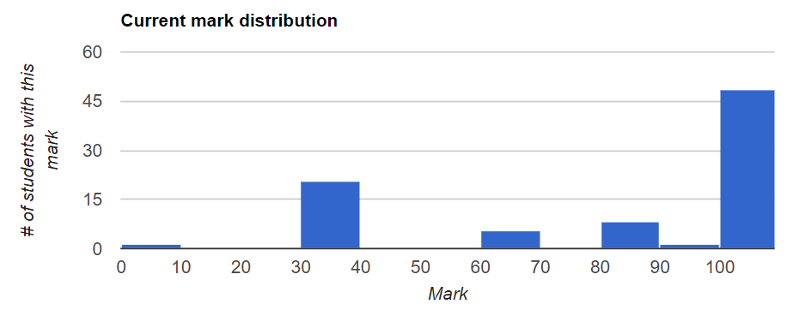
Lab 8 Review

Slide 3
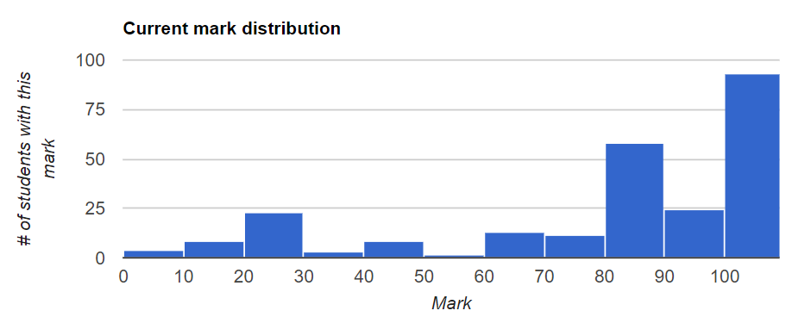
Assignment 1

Slide 4
MVC
The MVC pattern splits a GUI program into 3 layers
The models are Java objects that represent the data of your application and the operations on that data.
The views are the components that represent the graphical user interface of your application. Views “observe” data in the models.
The controllers are the components that handle user interaction. Controllers “observe” events that occur in the views.

Slide 5
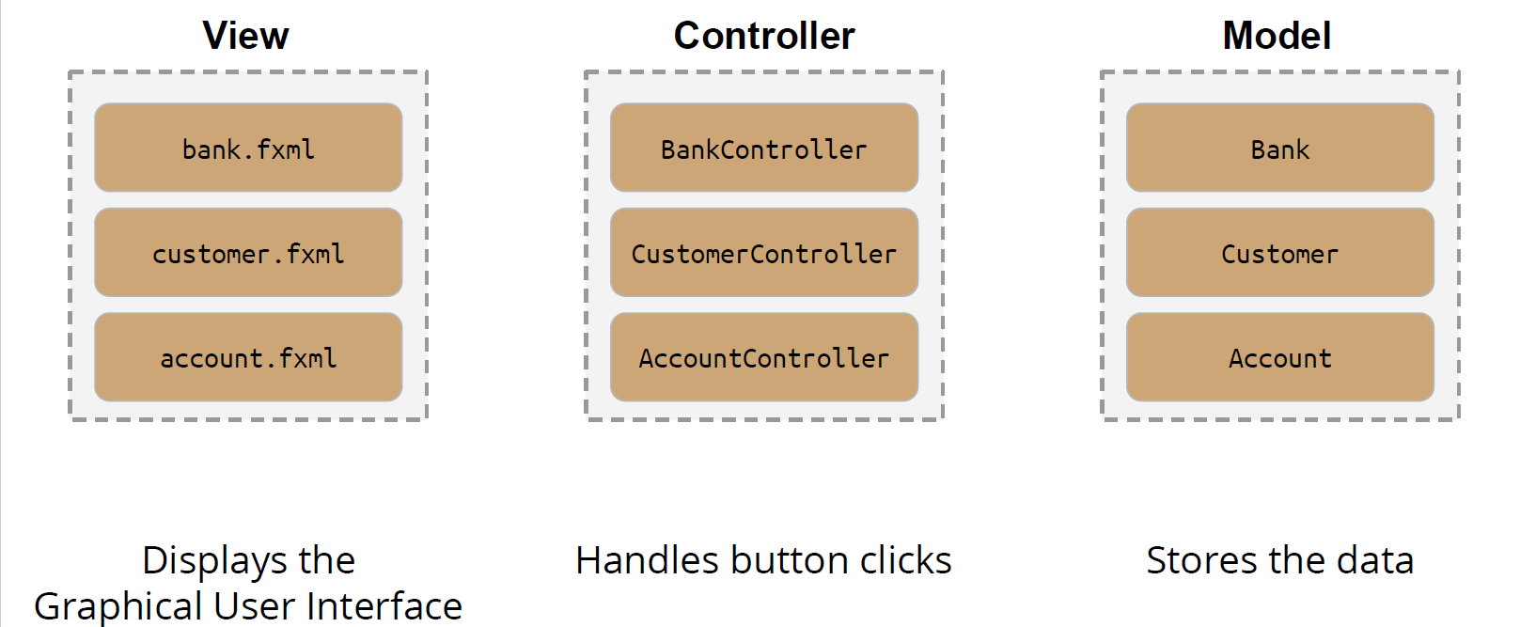
MVC Overview

Slide 6
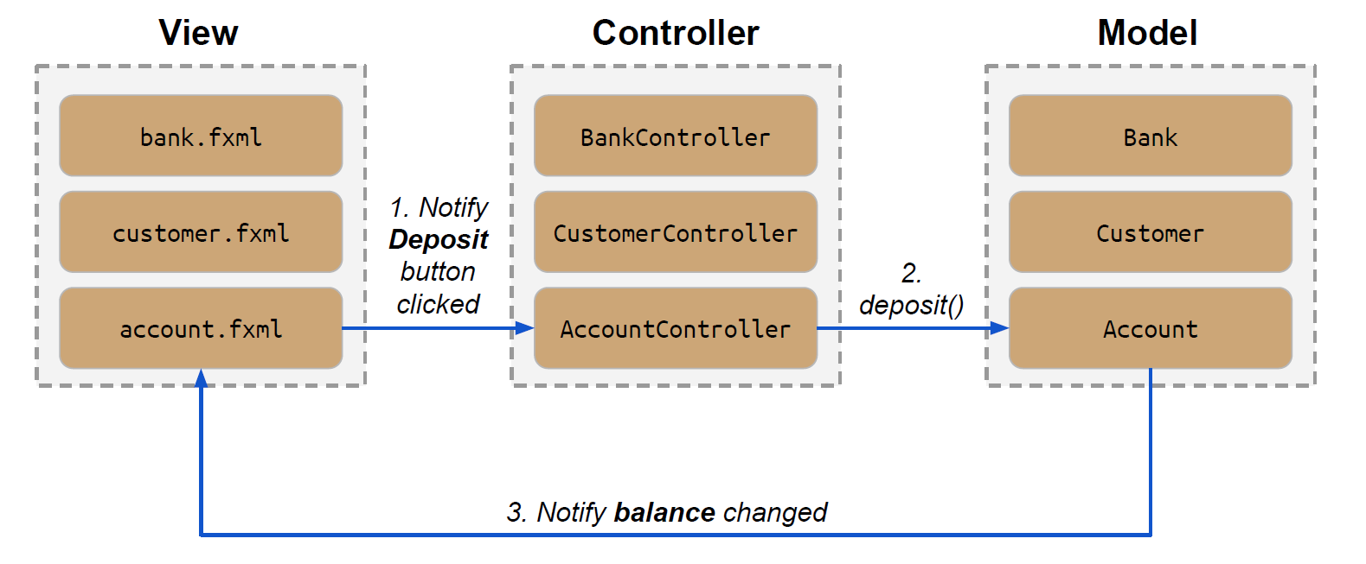
MVC Observers

Slide 7
Property
Property pattern
JavaBeans Property
Java FX Property Patterns
Each property implements the observer pattern
The View can be notified whenever a property changes

Slide 8
Which JavaFX property should be used...
For “id”?
Immutable property
For “name”?
Read Write property
For “submission”?
Immutable property with mutable state
For “mark”?
Read Only property
Student
int getId()
String getName()
void setName(String name)
Submission getSubmission()
int getMark()
void addToMark(int amount)

Slide 9
Property bindings
Goal: Property p1 is updated whenever property p2 changes.
i.e. p1 observes p2.
p1.bind(p2);
Goal: Properties p1 and p2 are both updated whenever the other changes.
i.e. p1 observes p2 and p2 observes p1
p1.bindBidirectional(p2);

Slide 10
Expression bindings in FXML
FXML supports unidirectional property bindings through ${...} notation.
FXML does not support bidirectional bindings. They must be done in Java.
The JavaFX expression binding language supports:
● Dot notation for properties. e.g. controller.account.balance
● Literals: “a string”, ‘a string’, 3.45, 27, null, true, false
● Operators: +, -, *, /, !, &&, ||, …..

Slide 11
Lab 9
30-40min intro/demo
Coding - remaining time
Topics: MVC architecture
FXML
properties
The techniques practices and assessed in this lab will form the basis for Assignment 2, and so care should be taken to sufficiently prepare for it and to spend the required time to complete it.

Slide 12
Assignment 2
1. Judging criteria
According to the subject outline, the marking on assignment 2 is a combination of automated PLATE marking, peer marking in Week 12 and marking by the subject coordinator.
2. The due date of Assignment 2 is 11:59 pm on 3rd June.
To avoid losing marks of peer marking in week 12, you must submit the assignment 2 by the due time. Failure to submit due to server load near the due date will not be considered as an acceptable excuse for submitting late.

Slide 13
Assignment 2
3. The Assignment 2 discussion board has been set up on UTSOnline so that students can ask questions, and other students can reply. The course coordinator will only post a reply only if the student response was wrong, or in the case of correcting a mistake in the assignment specification. You must not post or share Java code to the discussion board. The board is there to help you, not to provide the solution.
4. FAQs (Frequently Asked Questions) and their answers will be posted on PLATE alongside the assignment specification. If you have a question, check the FAQ first; it may already be answered there.

Slide 14

Contact
Subject Coordinator and Lecturer: Angela Huo
Email: huan.huo@uts.edu.au
Contact information on UTSOnline

